Slide 1
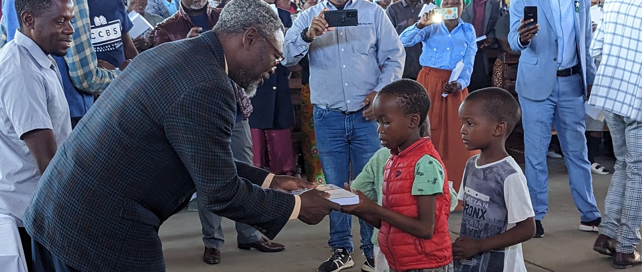
You will teach them to your children and talk about them when you sit in your house, when you walk on the road, when you lie down, and when you get up. You will write them on the doorposts of your house and on your city gates (Deut. 11:19-20).
All Scripture taken from the English Unlocked Literal Bible (ULB), ©2017, 2022 Wycliffe Associates, Available at https://bibleineverylanguage.org/translations, licensed under the Creative Commons Attribution-ShareAlike 4.0 International License.
The English ULB is based on the unfoldingWord® Literal Text, CC BY-SA 4.0. The original work of the unfoldingWord® Literal Text is available at https://unfoldingword.bible/ult/.
Scripture Accessibility

Slide 2
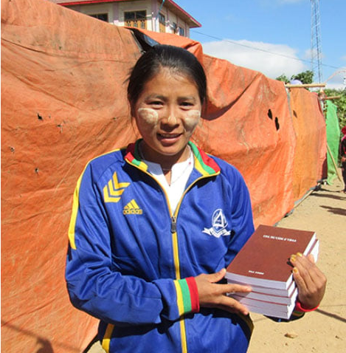
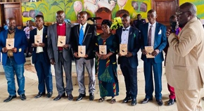
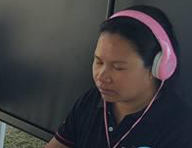
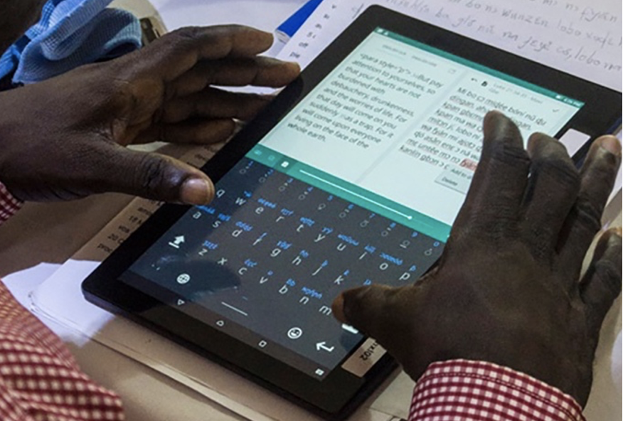
How will Scripture be
made available?

Slide 3





?

Slide 4
Think things through together
Discuss questions for your type of translation

